Slide 1
Pain & Acupuncture

Slide 2
What is Pain?
An unpleasant sensory and emotional experience associated with actual or potential tissue damage.
  NOCICEPTION（“the neural processes of encoding and processing noxious stimuli.）
  PAINFUL
  SUFFERING
  PAIN BEHAVIOR
Pain is always subjective

Slide 3
What is Pain?
One of the body’s defense mechanisms - warns the brain that its tissues may be in jeopardy
May be triggered without any physical damage to tissues.
Acute pain is the primary reason people seek medical attention and the major complaint that they describe on initial evaluation
Chronic pain can be so emotionally and physically debilitating that it is a leading cause of suicide.

Slide 4
The Nervous System and Pain
Somatosensory
System
Brain
Somatosensory
Cortex
Thalamus
Spinal Cord
Dorsal Horn
Ventral Root
PNS
Afferent Neuron
Efferent Neuron
A-delta Fibers
C-Fibers

Slide 5
PNS – Nerve Fiber Types
Afferent – Sensory Neurons
  Three Types Are Important to Understand Pain
    A-delta fibers – smaller, fast transmitting, myelinated fibers that transmit sharp pain
      Mechanoreceptors – Triggered by strong mechanical pressure and intense temperature
    C-fibers – smallest, slow transmitting, unmyelinated nerve fibers that transmit dull or aching pain.
      Mechanoreceptors – Mechanical & Thermal
      Chemoreceptors – Triggered by chemicals released during inflammation
    A-beta fibers – large diameter, fast transmitting, myelinated sensory fibers
Efferent – Motor neurons
Notes:
Myelination increases the speed of transmission and so sudden, sharp pain gets transmitted to the cerebral cortex faster than dull or aching pain. This may be important for survival. The motivational and affective elements of pain appear to be influenced strongly by the C-fibers. They project onto the thalamus, hypothalamus, and amygdala.
The A-delta fibers project onto particular areas of the thalamus and sensory areas of the cerebral cortex.
Neurotransmitters are also involved, in particular, substance P.

Slide 6
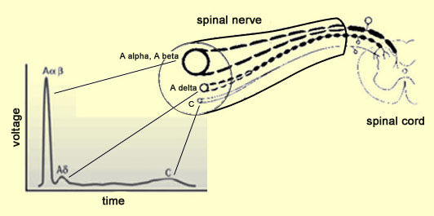
Nerve Fiber Types

Slide 7
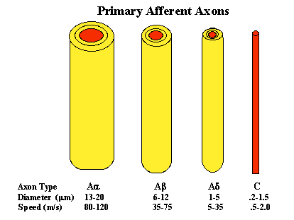

Slide 8
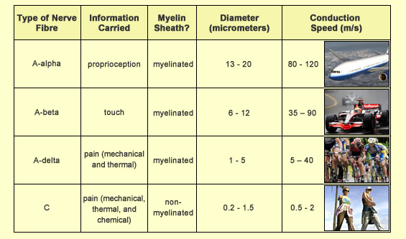
Nerve Fiber Types

Slide 9
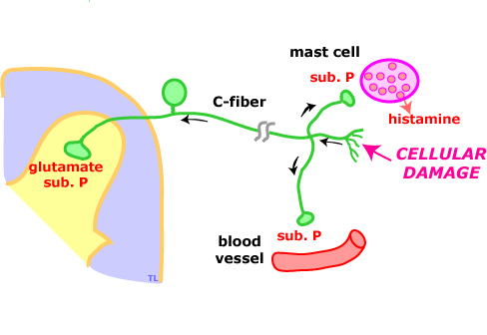

Slide 10
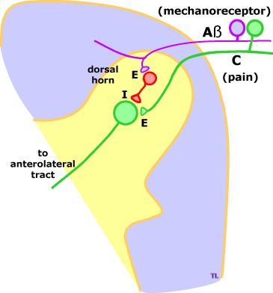

Slide 11
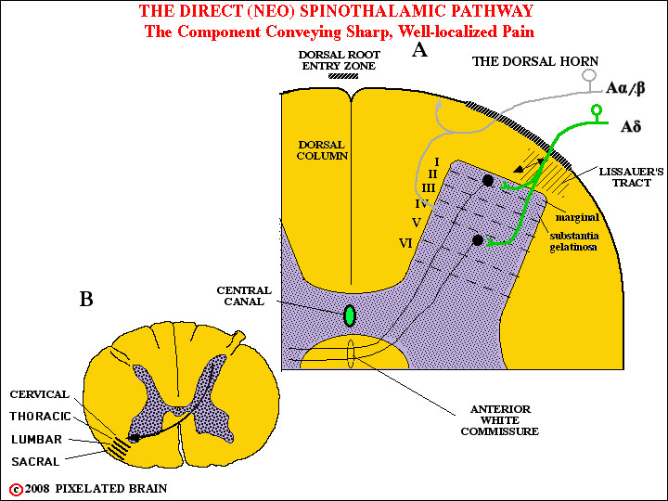

Slide 12
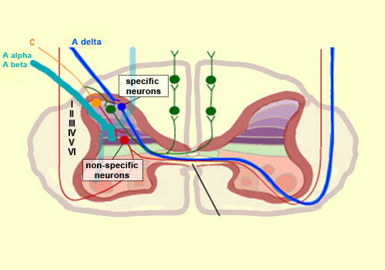

Slide 13
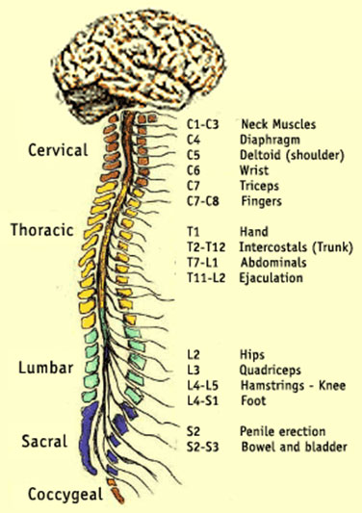
Spinal Cord
Multiple ascending and descending tracts of interneurons (connect afferent & efferent)
Afferent Neurons – Enter to dorsal (back) side
Efferent Neurons – Exit the ventral (front) side

Slide 14
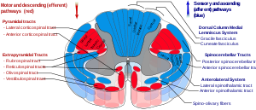
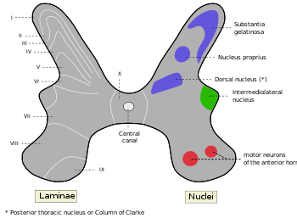
Spinal Cord
Spinal Layers
  Spinal grey matters divided into 10 layers
Substantia Gelatinosa
  Composed of a layer of cell bodies running up and down the dorsal horns of the spinal cord
  Receive input from A and C-fibers
  Activity in SG inhibits pain transmission

Slide 15
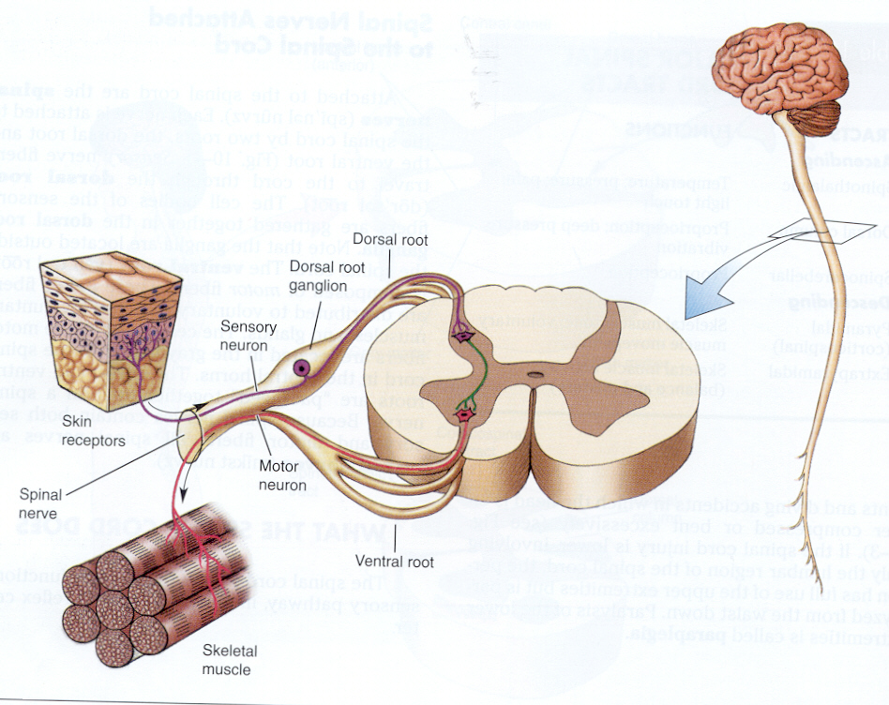

Slide 16
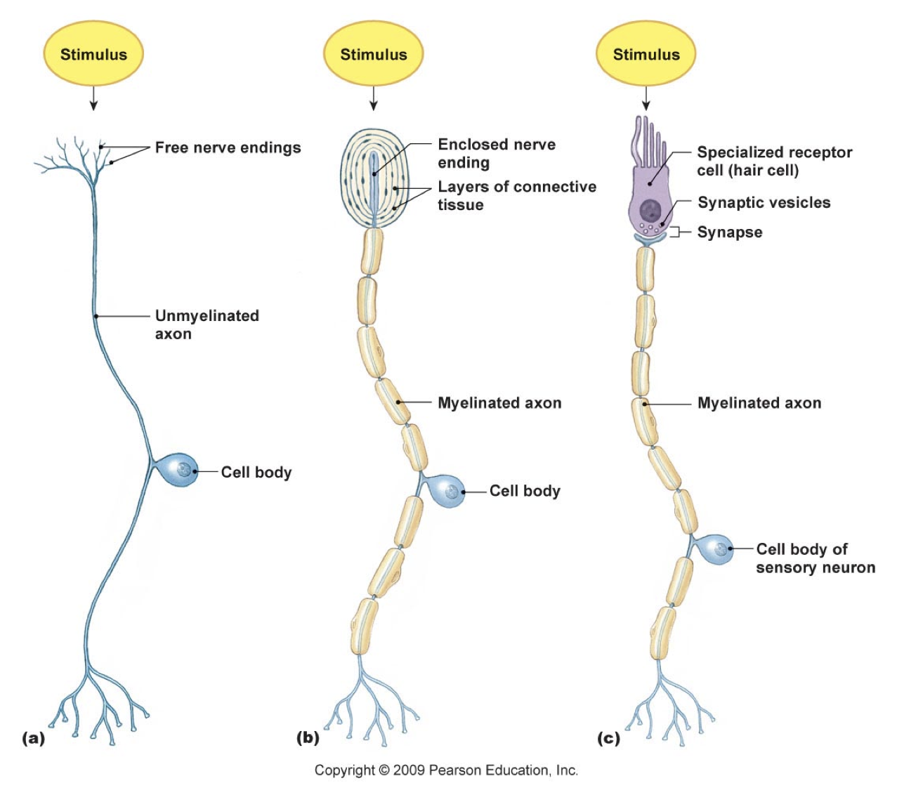

Slide 17
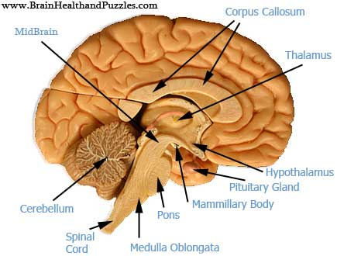
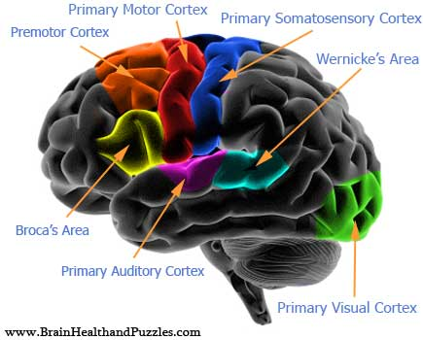
The Brain
Thalamus
Somatosensory Cortex

Slide 18
Thalamus
Somatosensory Cortex

Slide 19
Somatosensory Cortex

Slide 20
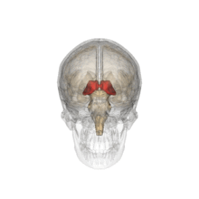
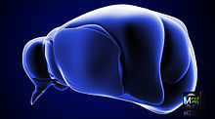
Thalamus
The sensory switchboard of the brain
Located in the middle of the brain

Slide 21
Somatosensory Cortex
Area of cerebral cortex located in the parietal lobe right behind the frontal lobe
Receives all info on touch and pain.

Slide 22
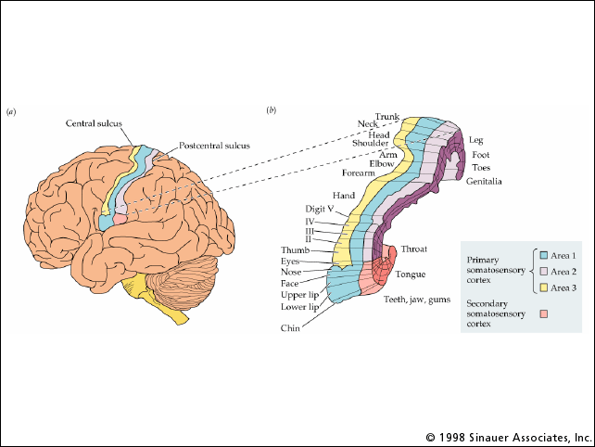
Somatosensory Cortex

Slide 23
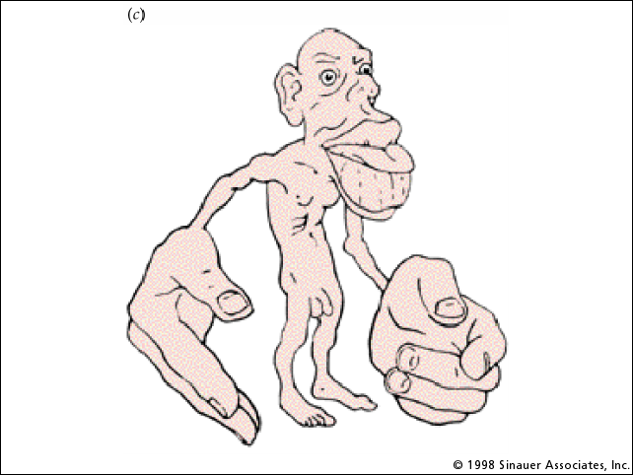
Somatosensory Cortex
Somatotopically organized

Slide 24
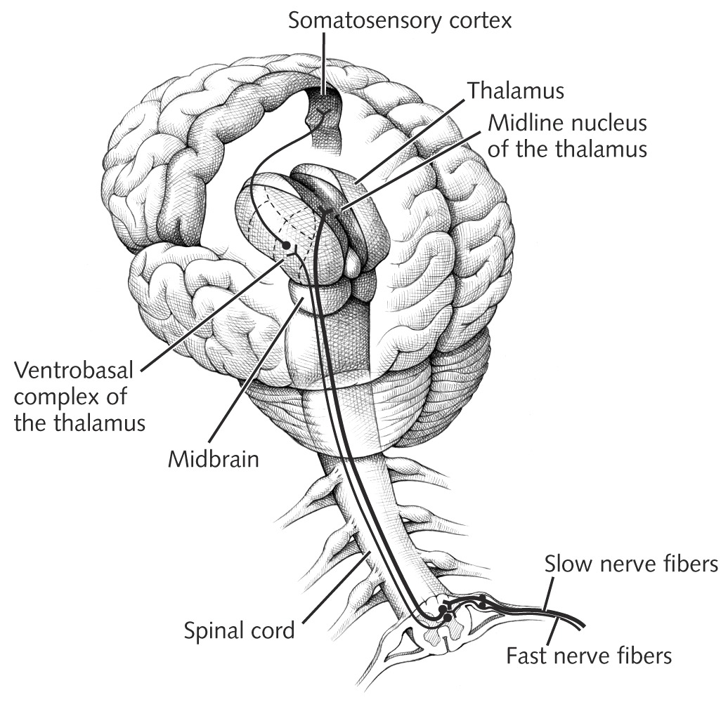
Pain Pathways – Going Up
Pain information travels up the spinal cord through the spino-thalamic track (2 parts)
  PSTT
    Immediate warning of the presence, location, and intensity of an injury
  NSTT
    Slow, aching reminder that tissue damage has occurred

Slide 25
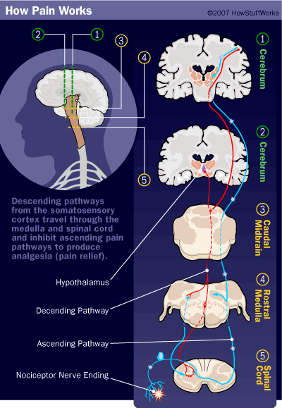
Pain Pathways – Going Down
Descending pain pathway responsible for pain inhibition

Slide 27
The Neurochemicals of Pain
Pain Initiators
  Glutamate - Central
  Substance P - Central
  Brandykinin - Peripheral
  Prostaglandins - Peripheral
Pain Inhibitors
  Serotonin
  Endorphins
  Enkephalins
  Dynorphin

Slide 28
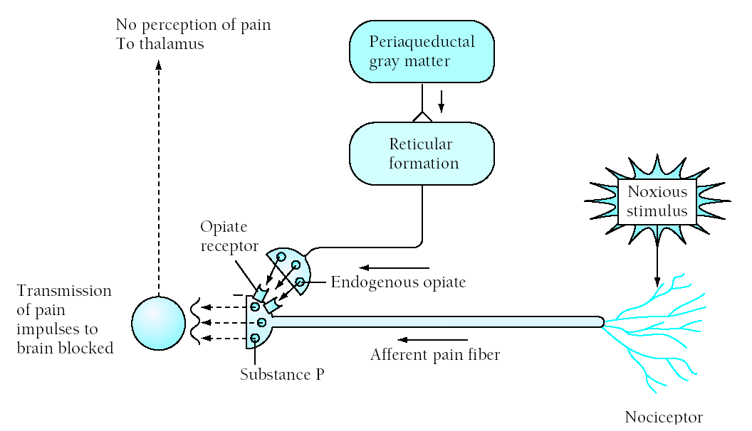

Slide 29
Theories of Pain
Specificity Theory
  Began with Aristotle
  Pain is hardwired
    Specific “pain” fibers bring info to a “pain center”
  Refuted in 1965
Gate Control Theory

Slide 30
Gate-Control Theory –
Ronald Melzack (1960s)
Described physiological mechanism by which psychological factors can affect the experience of pain.
Neural gate can open and close thereby modulating pain.
Gate is located in the spinal cord.
  It is the SG

Slide 31
Opening and Closing the Gate
When the gate is closed signals from small diameter pain fibres do not excite the dorsal horn transmission neurons.
When the gate is open, pain signals excite dorsal horn transmission cells

Slide 32
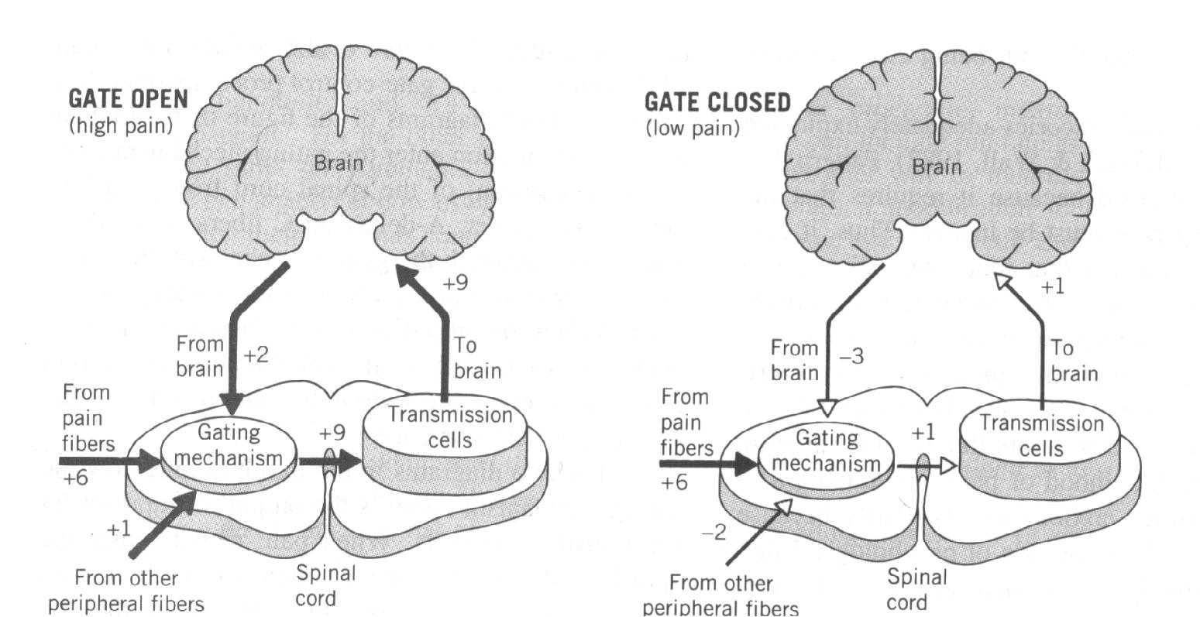

Slide 33
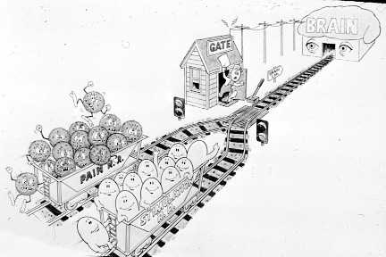

Slide 34
Three Factors Involved in Opening and Closing the Gate
The amount of activity in the pain fibers.
The amount of activity in other peripheral fibers.
Messages that descend from the brain.

Slide 35
Conditions that Open the Gate
Physical conditions
  Extent of injury
  Inappropriate activity level
Emotional conditions
  Anxiety or worry
  Tension
  Depression
Mental Conditions
  Focusing on pain
  Boredom

Slide 36
Conditions That Close the Gate
Physical conditions
  Medications
  Counter stimulation (e.g., heat, massage)
Emotional conditions
  Positive emotions
  Relaxation, Rest
Mental conditions
  Intense concentration or distraction
  Involvement and interest in life activities

Slide 37
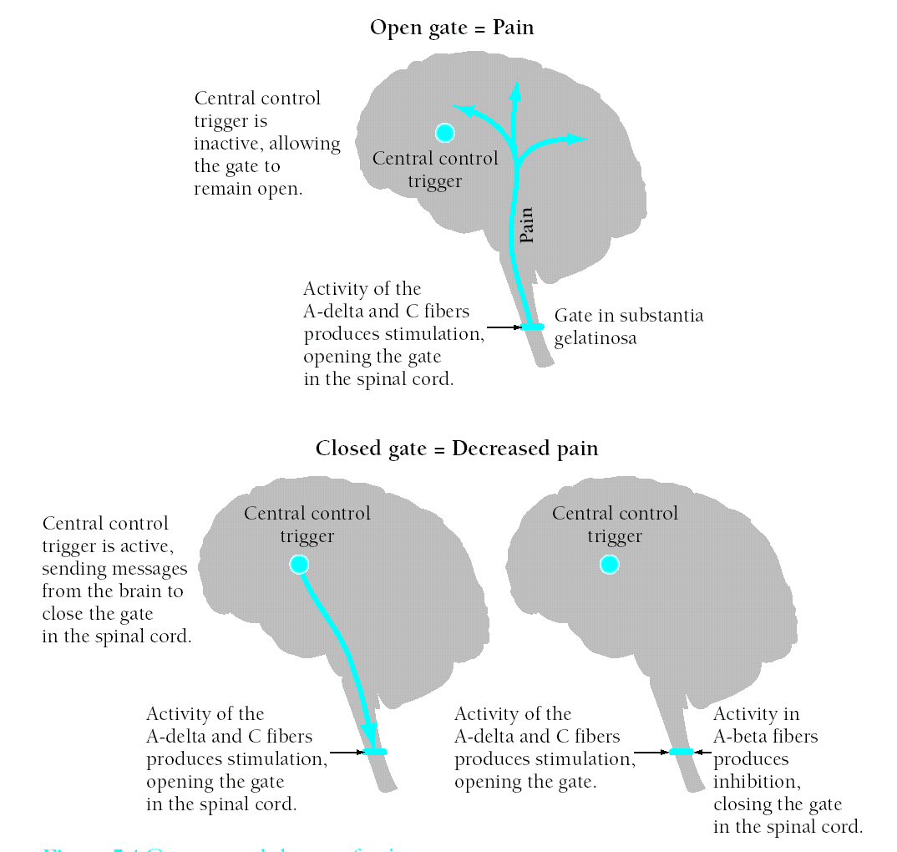

Slide 38
Categories of Pain
Pain can be categorized according to its origin:
  Cutaneous – Skin, tendons, ligaments
  Deep somatic - Bone, muscle connective tissue
  Visceral – Organs, cavity linings
  Neuropathic – Nerve pain
By certain qualities
  Radiating
  Referred
  Intractable

Slide 39
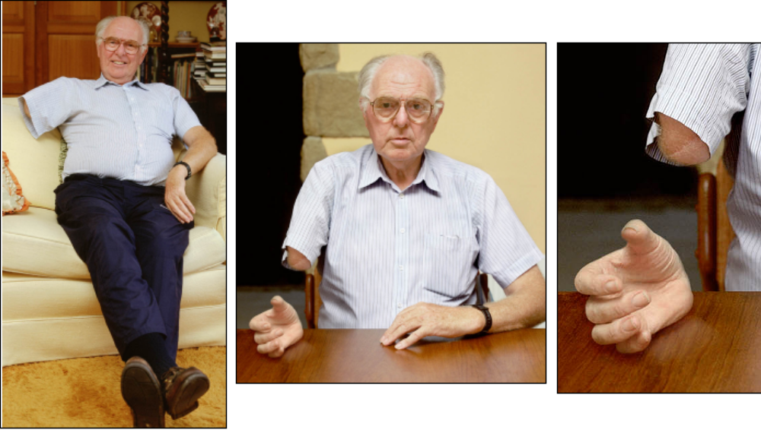
Phantom Limb Pain
Pain in a absent body part
Very common in amputees
Ranges from tingling top sensation to pain

Slide 40
Acute Pain
ACUTE – Pain lasting for less than 6 months
  Highly correlated to damage
  Anxiety abates w/treatment
  De-activation often helpful

Slide 41
Chronic Pain
Pain lasting > 6 months
  Not correlated to tissue damage
  Learned/Reinforced
  Often associated w/psychopathology or coping problems
  More likely to abuse alcohol and drugs
  Leads to shutting down
  Typically does not respond to drugs very well
  Activity is the best medicine

Slide 42
Measuring Pain
Physiological
  Unreliable
Self-report
  Behavioral observations
  Rankings
  Pain questionnaires
  Psych tests

Slide 43
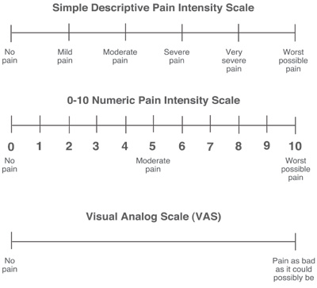
Use a standard scale to track the course of pain

